Slide 1
Why do we sleep?
Oleynikov Vladislav Petrovich
Budker Institute of Nuclear Physics, 18 May 2015
From http://www.bbc.com/news

Slide 2
Content
10 minutes
Introduction
Why do I sleep?
What happens when I don't get enough sleep?
Why is it hard to think when I am tired?
What is the role of dreaming?
Concluding comments

Slide 3

Introduction
Sleep made our ancestors vulnerable to attack from wild animals
Some sort of evolutionary advantage

Slide 4
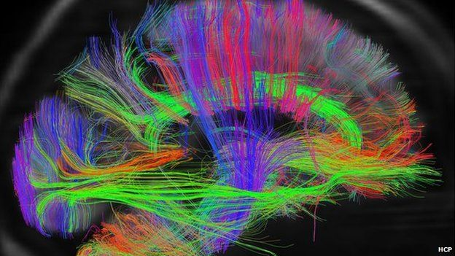
Why do I sleep?
You can think of it like having a house party. You can either entertain the guests or clean up the house, but you can't really do both at the same time

Slide 5
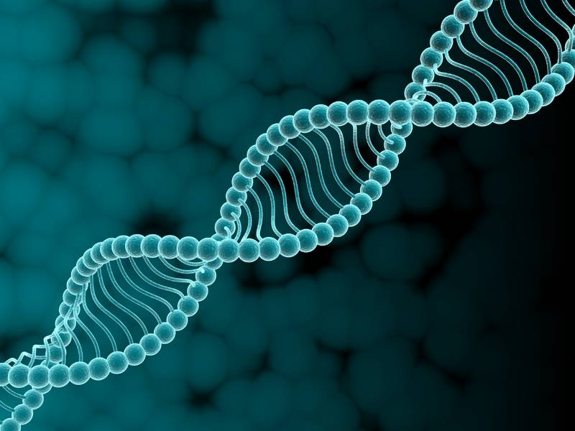
What happens when I don't get enough sleep?
Researchers at Surrey University in Guildford have found that genes involved in inflammation seem to increase their activity
In fact the consequent activation of the immune system might increase the risk of heart disease and stroke

Slide 6
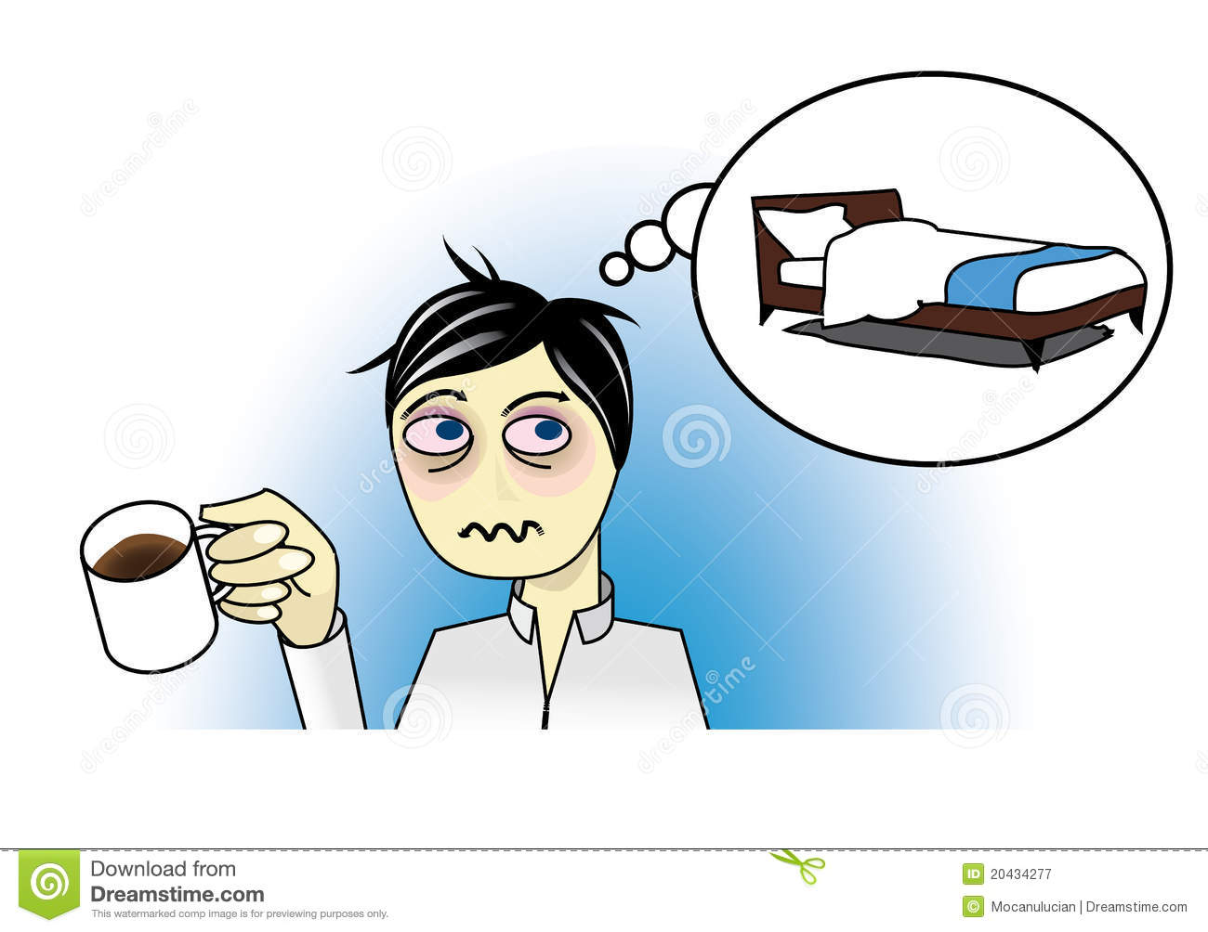
Why is it hard to think when I am tired?
Research suggests that parts of the human brain may well be asleep when it is sleep-deprived
Studies on whales and dolphins show that when asleep they continue to use half of their brain to swim and come up to the surface for air

Slide 7
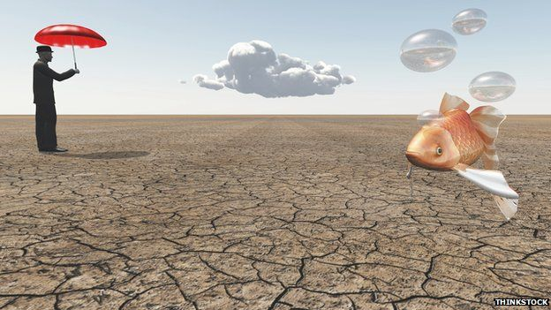
What is the role of dreaming?
More recently, a team at the ATR Computational Neuroscience Laboratories in Kyoto in Japan has begun trying to answer some of these questions by building the beginnings of a dream-reading machine

Slide 8

Concluding comments
The investigators hope to find out soon whether the old adage "early to bed and early to rise" really does make us, if not "wealthy and wise", at least "healthy and wise".

Slide 9
Thank you for your attention!

